Slide 1
COSSAP-RSAT RFA (Request for Application)

Slide 2
Overview
UEIs & SAM
RFA Application
Subaward Requirements
Program Requirements
Timeline
Questions
Contact Information

Slide 3
UEIs & SAM
Unique Entity Identification & System for Awards Management
Annual updates required
Needs to be updated at least 30 to 60 days before it is set to expire

Slide 4
RFA Application

Slide 5
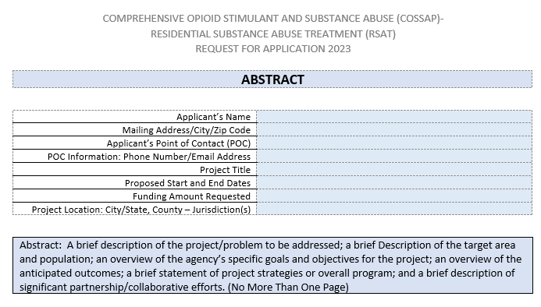
Abstract

Slide 6
Cover Page

Slide 7
Program Narratives

Slide 8
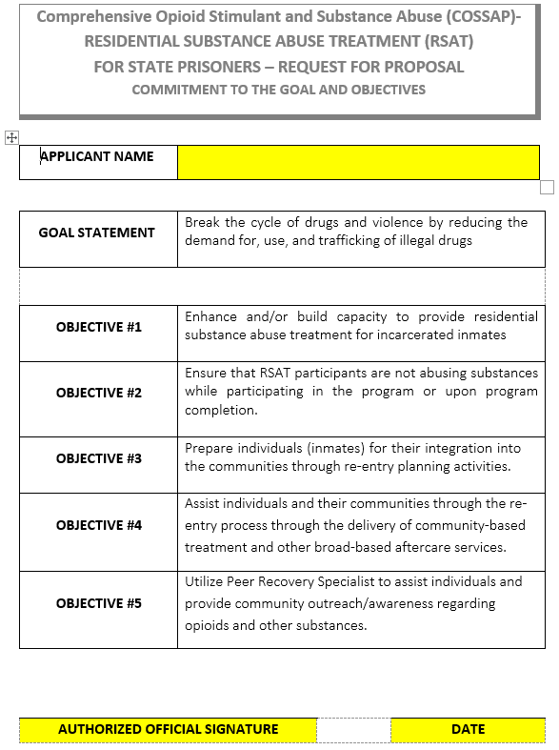
Goals Objectives Commitment

Slide 9
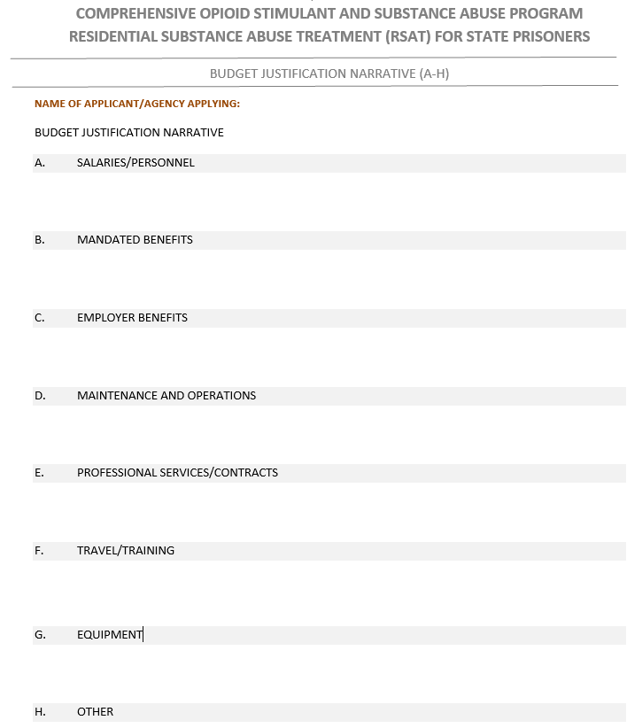
Budget Justification Narrative
Please remember to give a detailed account of all salaries, mandated benefits, and employer benefits. Example: John Doe is paid at a rate of $23.00/hr. at a 5-month salary of $18,400.

Slide 10
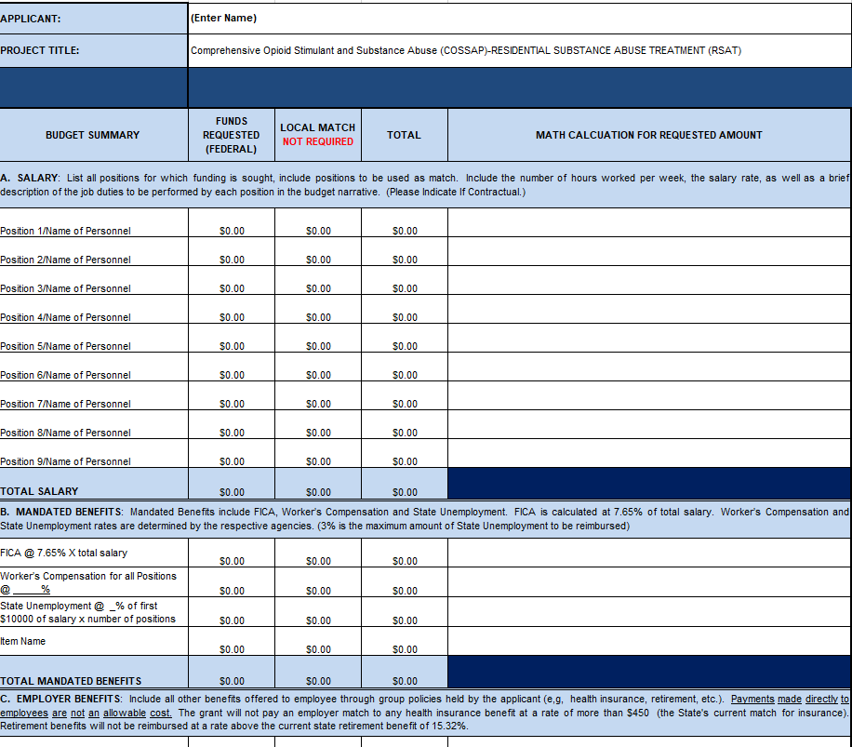
Detailed Budget

Slide 11
Application Checklist

Slide 12
Clearinghouse Submission
Applications/Proposals must be submitted to the IGS-DFA JAG email at IGS.Applications@dfa.arkansas.gov.

Slide 13
SF-424

Slide 14
Subaward Requirements
Subgrantee Contracts
All consultant and contractual services shall be supported by written contracts stating the services to be performed, rate of compensation, and length of time over which the services will be provided. This shall not exceed the length of the contract period.
A copy of all written contracts for contractual or consultant services shall be forwarded to the Arkansas Department of Finance and Administration upon their ratification.
Payments shall be supported by detailed statements outlining the services rendered and the cost billed during the period covered.
Quarterly Reporting Requirements
Reporting due every 3 months for each quarter activity period.
Reports are to be submitted in PMT within 15 days following the close of the quarter.
Subrecipient Monitoring
All grant awards will be monitored by either desk reviews or site visits.

Slide 15
Program Requirements
Be
Funds must be used to implement a jail-based program, which includes aftercare services and peer recovery.
Separate
Separate program participants from general population if possible.
Hire/Contract
Hire/Contract Peer Recovery Specialist.
Be
Aftercare services must be provided (stipulations located in Instructions).
Drug
Drug and alcohol testing required of participants.

Slide 16
Timeline
Release Date: Wednesday, February 22, 2023
RFP/RFA Due Date: Wednesday, March 15, 2023
RFA Technical Assistance Workshop: PowerPoint Presentation Voiceover/Audio
Project Period: April 1, 2023 to September 30, 2023

Slide 17
QUESTIONS?

Slide 18
DFA-IGS Staff Contact Information
Desirae’ Walker, Program Coordinator
Desirae.walker@dfa.Arkansas.gov
501-682-5022
Tiffany Evans, Grants Analyst
tiffany.evans@dfa.Arkansas.gov
501-683-1743
Natyia Smith, Grants Analyst
natyia.smith@dfa.Arkansas.gov
501-682-4798
Kathleen Kenney, Fiscal Support Specialist
kathleen.kenney@dfa.Arkansas.gov
501-682-5254
Letha Bell, Assistant Administrator
Letha.Bell@dfa.arkansas.gov
501-682-1468
Email: IGS.JAG@dfa.arkansas.gov
Phone: 501-682-1074

